Slide 1
Title Slide
Project Title:- Quiz Application
Your Name:-Ravi Rao
Awnish Singh
Harshit Tripathi
Mohd Suhail
University Name:- Gla University Mathura
Department Name:- Computer Science & Application
Date:- 29/11/2023

Slide 2
Introduction
This is a “QUIZ” application which gives the information about CSE core subjects. First of all, every student should register in registration page by using his/her name unique roll number, by creating username and password. After registering, they need to login every time to access their account.it contains 20 questions and marks will be allotted for the right one. References give the overall ideas and concepts included in the subjects.

Slide 3
Objectives
Thus the main objective of the research is to develop an interactive mobile application based on android platform to conduct quiz sessions in the class for different technical topics. On further enhancement this app can be used for the recruitment process of software companies which will be able to save time and efforts to eliminate unwanted candidates to appear for personal interview by travelling a long distance.

Slide 4
Problem Statement
PROBLEM STATEMENT QUIZ SYSTEM is a software developed to conduct an Online Quiz based on time constraints. Quiz System is accessed by entering the username and e-mail id which is added to the database. Before start of the Quiz, the rules and regulations are displayed that includes description of time limit, number of questions to be answered and scoring methods. Quiz is started by displaying ten questions with four options each based on category chosen ie General Knowledge, Verbal Reasoning and Computer Science. If the answer is correct, score is incremented by two and no negative marks for wrong answers. If the time exceeds 10 minutes or all the questions are answered the quiz is stopped .Final score will be displayed and updated in the database.

Slide 5
References
Web development documentation
Books on web application development
Online tutorials and forums

Slide 6
Methodology
We will use web development technologies such as HTML, CSS,React.Js,JavaScript,Backend(like node js). The application will be hosted on a web server, and we'll use a database system to store user data and quiz questions.

Slide 7
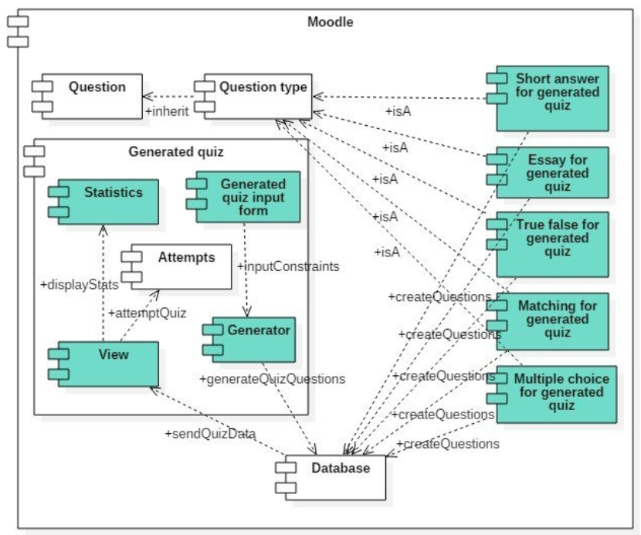
System Architecture

Slide 8
Implementation
We will follow a phased approach with milestones:
Project setup and planning
Database design and user authentication
Quiz creation and management features
Quiz-taking functionality
Scoring and result generation
User profile management
Testing and debugging
Deployment

Slide 9
Features
Easy way to test knowledge.
User-friendly website for easy understanding.
Can reduce usage of resources like paper.

Slide 10
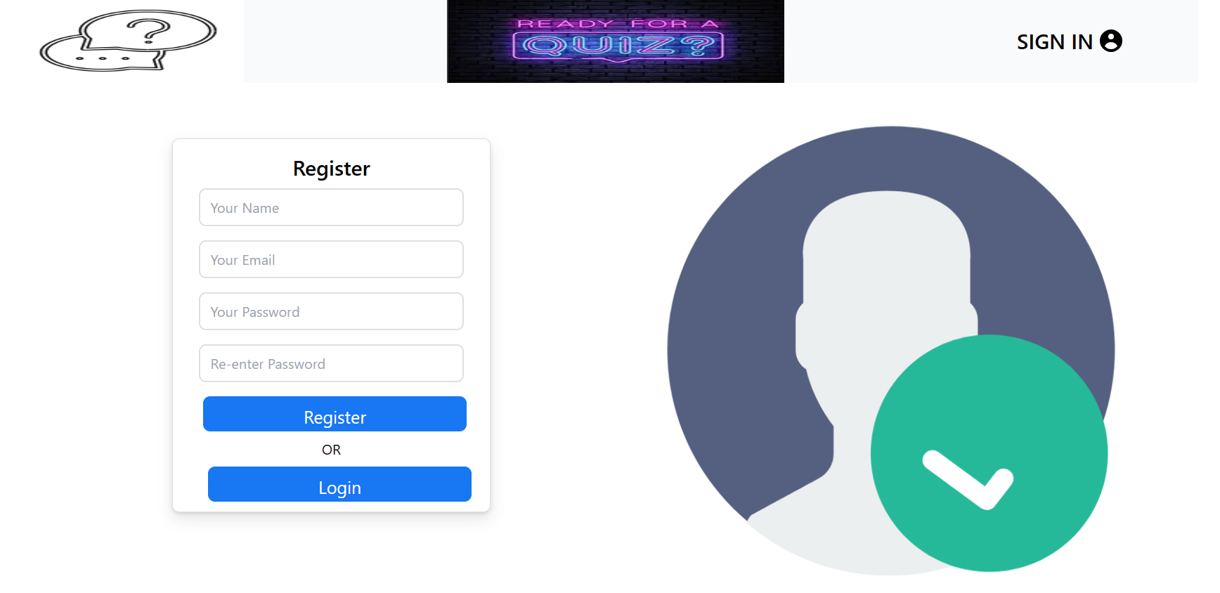
Results

Slide 11
What do you mean by Website?
A website is a collection of files accessed through a web address, covering a particular theme or subject, and managed by a particular person or organization. Its opening page is called a home page.

Slide 12
Scope
The Scope of this project is very broad in terms of gaining knowledge and sharing knowledge among world.
Few points are:-
Can be used anywhere any time as it is a web based application.
This Application will be used in educational institution as well as in corporate world.

Slide 13
Future Scope
This project has a vast scope as many other functionalities can be added
to it. In first place a timer cab added to each quiz. Due to no limited time
for the test students can find answerers to the questions anywhere else
which ultimately will not be an honest evaluation of their result. Also, to
prevent this many other functionalities can be added to the user side
especially to the student like restricting any kind of switching of tabs in
the browser and introduction of webcam for more honest evaluation of
the students. More creative way of showing result and deletion of test by
adding an administrative part to the system can be done. In the
administrative part addition and deletion of user can be done.

Slide 14
Conclusion
The Online Quiz Application project aims to provide an interactive and educational platform for users to create and participate in quizzes. We look forward to creating a valuable tool for learning and testing knowledge.

Slide 15
Thank you

